Slide 1
Repetition Statements (loops)
CSC103 – Programming Fundamentals
Instructor: Khurram Iqbal

Slide 2

Outline
For Loop
break and continue Statement
Nested Loops

Slide 3
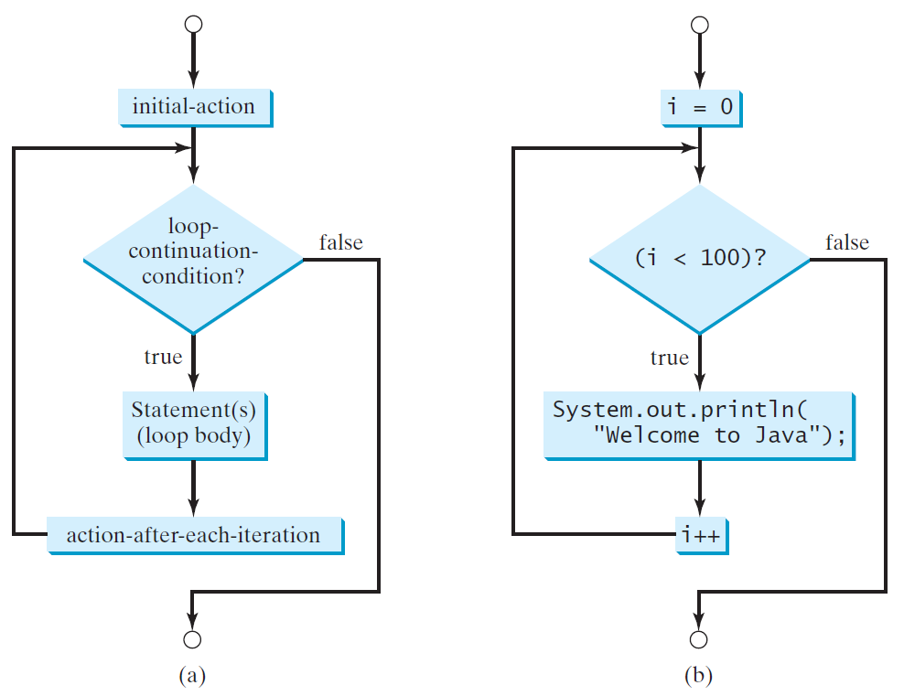
for Loops
for (initial-action; loop-continuation-condition; action-after-each-iteration) {
// loop body;
Statement(s);
}
int i;
for (i = 0; i < 100; i++) {
System.out.println("Welcome to Java!");
}

Slide 4
Note
The initial-action in a for loop can be a list of zero or more comma-separated expressions.
The action-after-each-iteration in a for loop can be a list of zero or more comma-separated statements.
Therefore, the following two for loops are correct. They are rarely used in practice, however.
for (int i = 1; i < 100; System.out.println(i++));
for (int i = 0, j = 0; (i + j < 10); i++, j++) {
// Do something
}

Slide 5
Note
If the loop-continuation-condition in a for loop is omitted, it is implicitly true.
Thus the statement given below in (a), which is an infinite loop, is correct. Nevertheless, it is better to use the equivalent loop in (b) to avoid confusion:

Slide 6
Caution
Adding a semicolon at the end of the for clause before the loop body is a common mistake, as shown below:
Logic Error
for (int i=0; i<10; i++);
{
System.out.println("i is " + i);
}

Slide 7
Caution, cont.
Similarly, the following loop is also wrong:
int i=0;
while (i < 10);
{
System.out.println("i is " + i);
i++;
}
In the case of the do loop, the following semicolon is needed to end the loop.
int i=0;
do {
System.out.println("i is " + i);
i++;
} while (i<10);
Logic Error
Correct

Slide 8
Which Loop to Use?
The three forms of loop statements, while, do-while, and for, are expressively equivalent; that is, you can write a loop in any of these three forms. For example, a while loop in (a) in the following figure can always be converted into the following for loop in (b):
A for loop in (a) in the following figure can generally be converted into the following while loop in (b) except in certain special

Slide 9
Recommendations
Use the one that is most intuitive and comfortable for you.
In general, a for loop may be used if the number of repetitions is known, as, for example, when you need to print a message 100 times.
A while loop may be used if the number of repetitions is not known, as in the case of reading the numbers until the input is 0.
A do-while loop can be used to replace a while loop if the loop body has to be executed before testing the continuation condition.

Slide 10
break

Slide 11
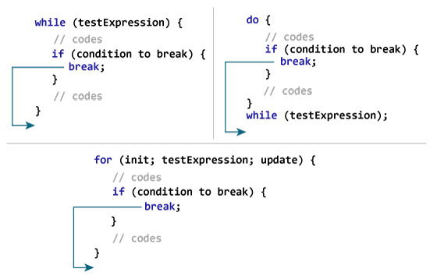

Slide 12
continue

Slide 13
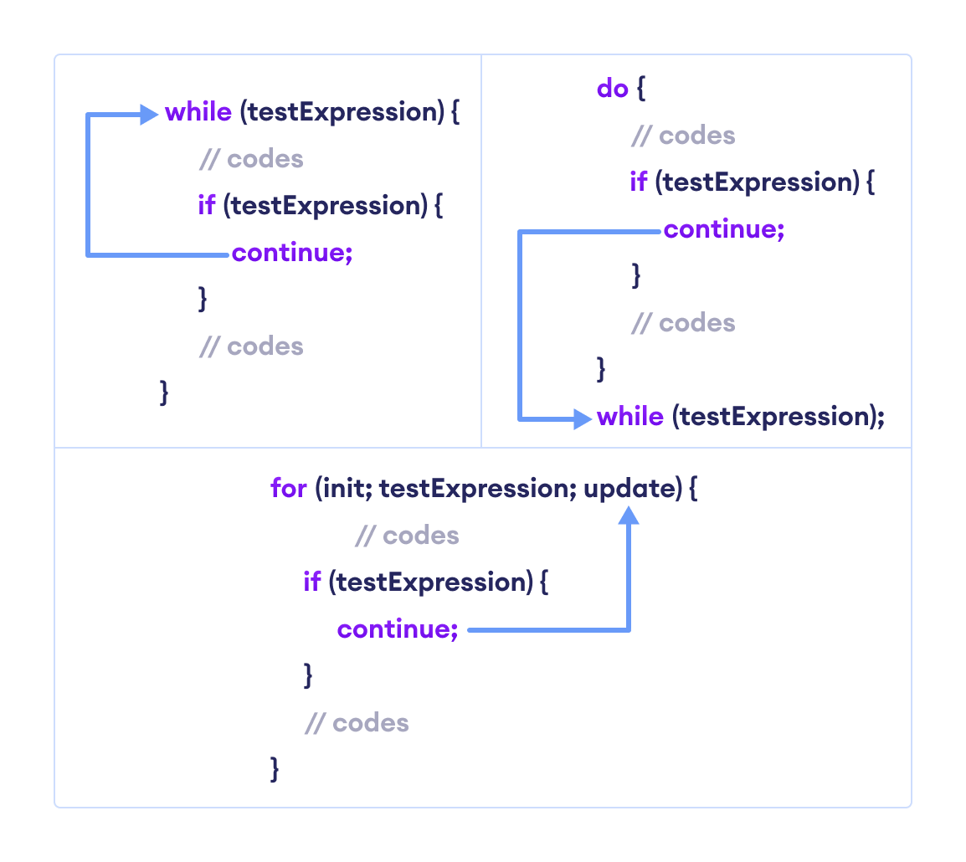

Slide 14
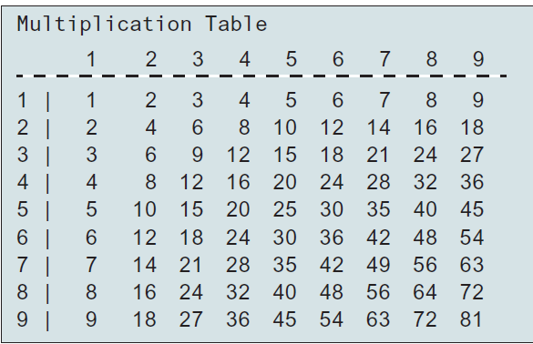
Nested Loops
Problem: Write a program that uses nested for loops to print a multiplication table.

Slide 15
